Slide 1
Leadership and Policy for Post-Secondary Transition
Notes:
INSERT TREE

Slide 2
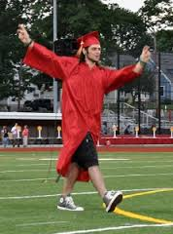
What is the BIG Picture?
Notes:
What is the big picture in education? 21st century…

Slide 3
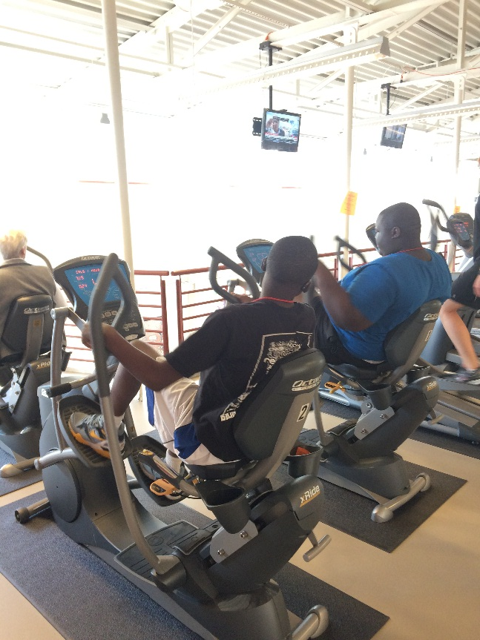
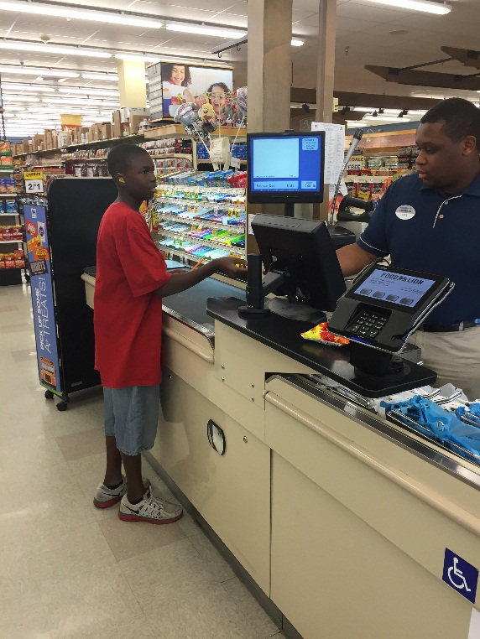
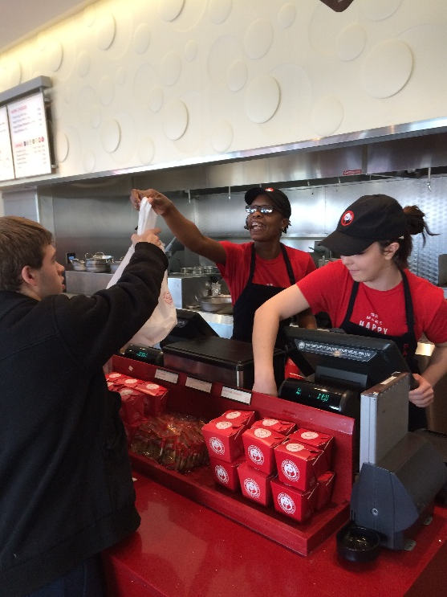
Conceptual Beliefs
Transition is NOT something separate we do…
Our kids our GENERAL education first…
Education is NOT something we do to kids.

Slide 4
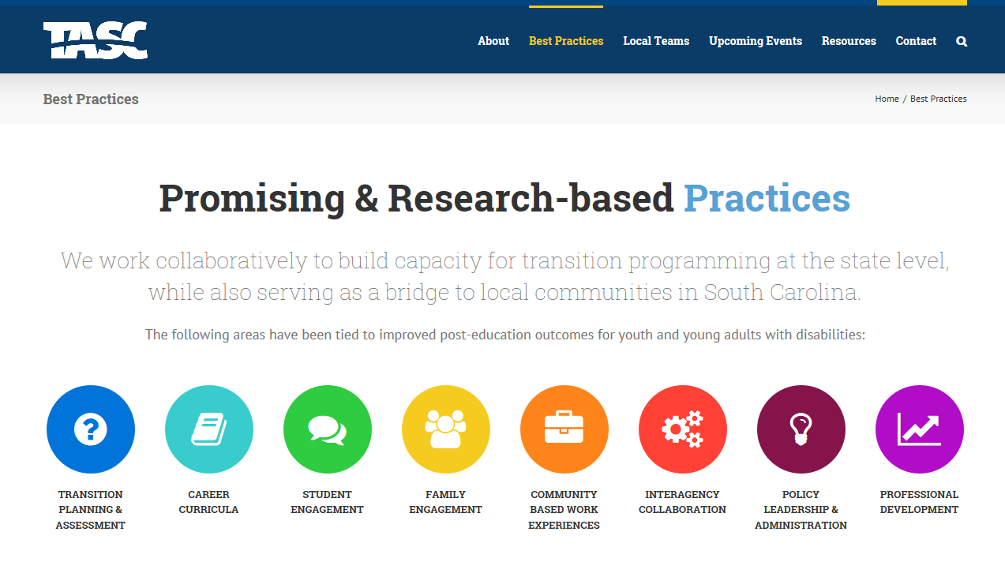

Slide 5
Overarching Considerations
Policies and Procedures:
How are you aligning your mission, resources, goals and activities to support the transition from school to work for all students?
Staff Knowledge, Experience & Access to Resources
How well are administrators, teachers and support staff equipped to tackle the task set forth under the school’s/district’s transition program?

Slide 6
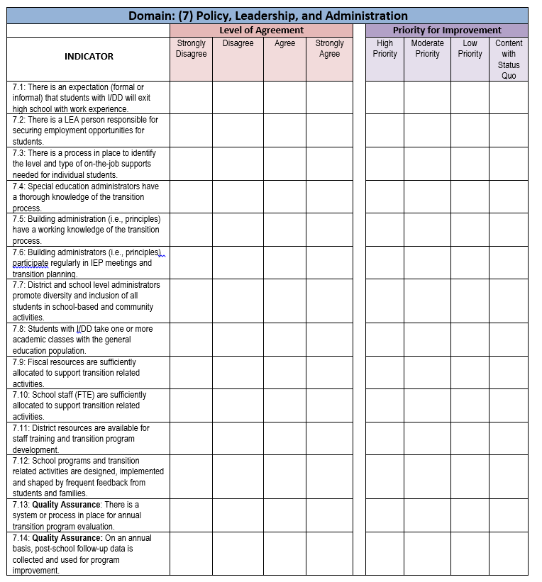
Quality Indicators for Secondary Transition: Program Check & Reflect Tool

Slide 8
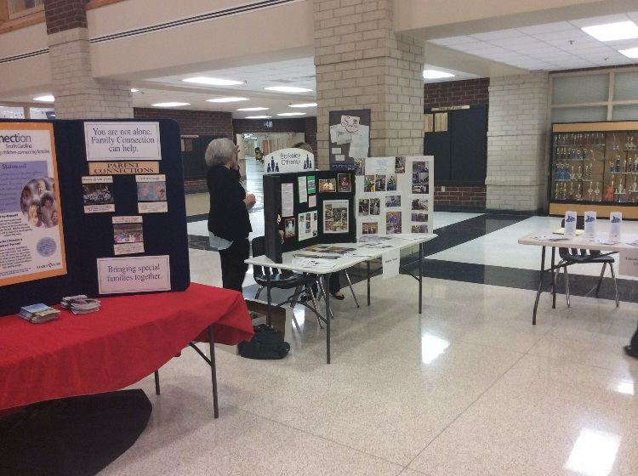
Policy, Leadership, Administration
Support and promote early planning efforts
Recruit individuals with specific responsibilities for transition to promote improved post-school outcomes for students with disabilities

Slide 9
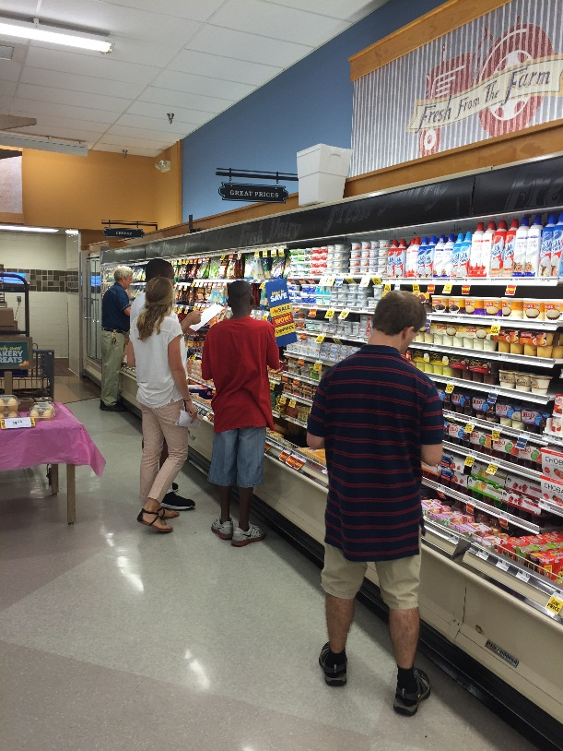
Policy, Leadership, Administration
Affect curriculum offerings and specify what types of classes/experiences can be pursued for credit
Create opportunities for valuable student community work activities

Slide 10
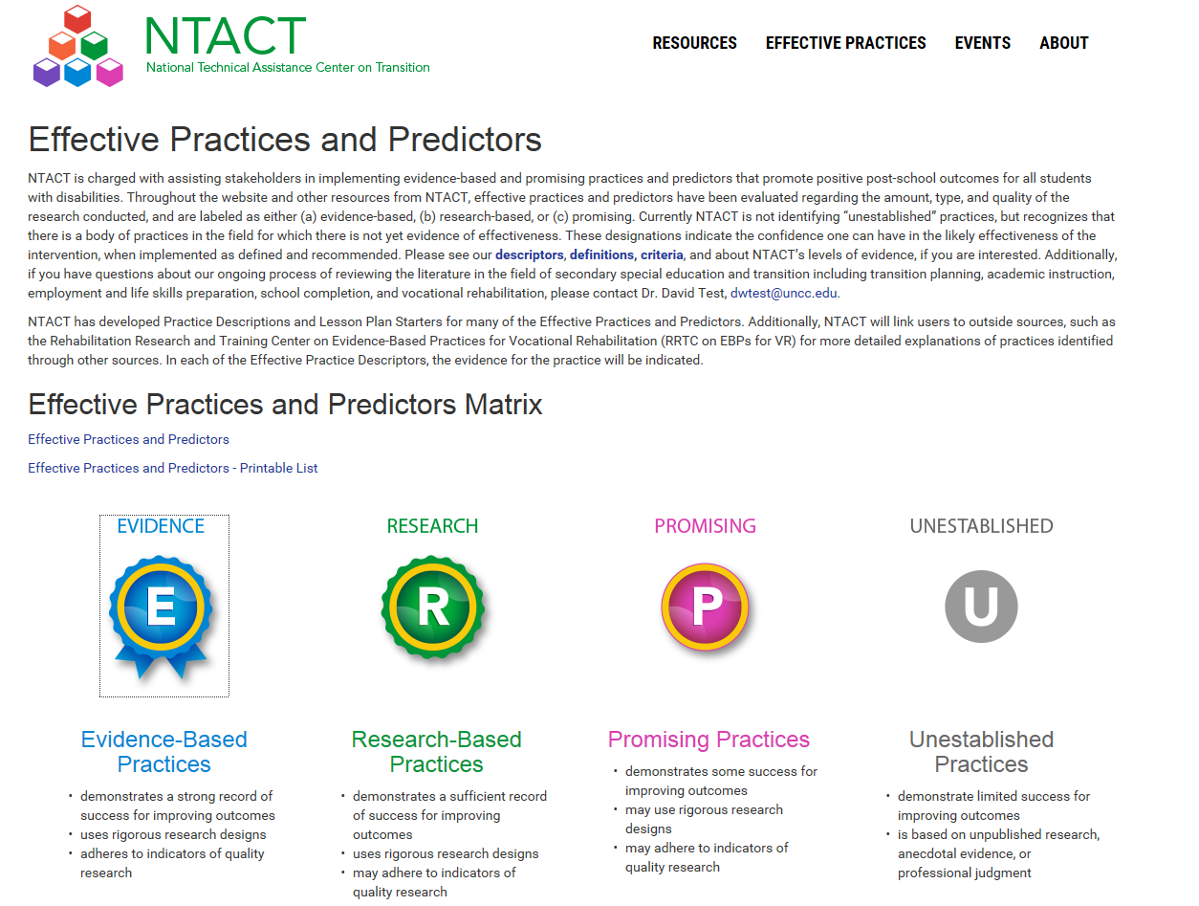
Policy, Leadership, Administration
Develop incentives and methods needed to implement evidence-based models, practices, and strategies

Slide 11
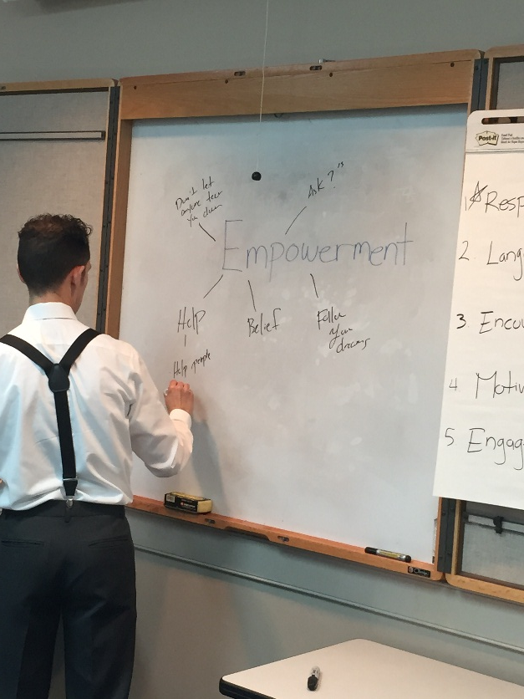
Policy, Leadership, Administration
Bring collaborative partners into the transition planning process
Build partnerships with universities to conduct research to demonstrate and validate new transition support strategies as well as monitor longitudinal outcomes.

Slide 12
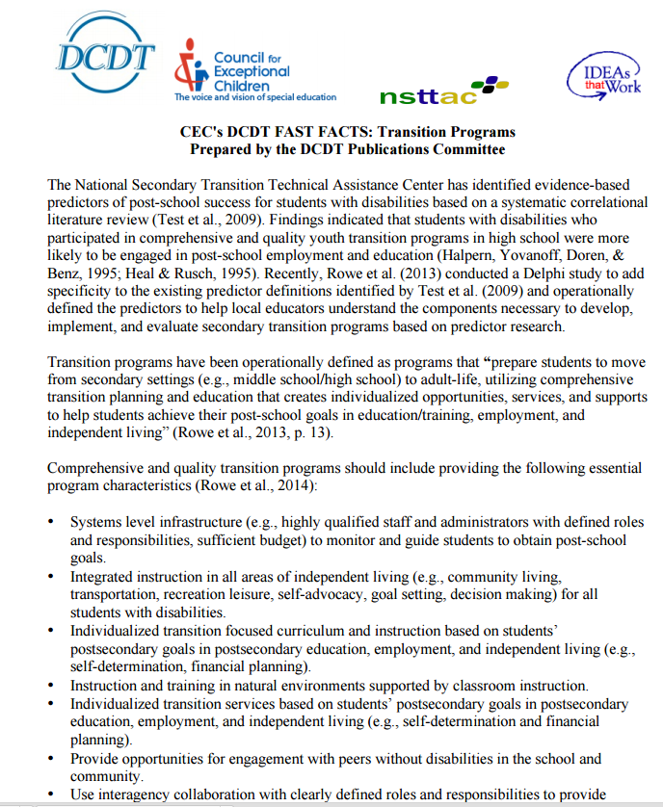

Slide 13
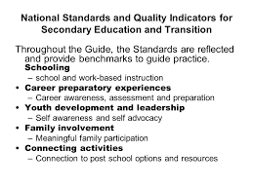
National Alliance for Secondary and Transition
National Standards
Quality Indicators
Transition Toolkit
Notes:
What is the NASET?

Slide 14
Questions?

